Slide 1

GAIL(India) Limited
Presented By:-
BIBEKANANDA MISHRA
ROLL NO:- PC12MBA024

Slide 2
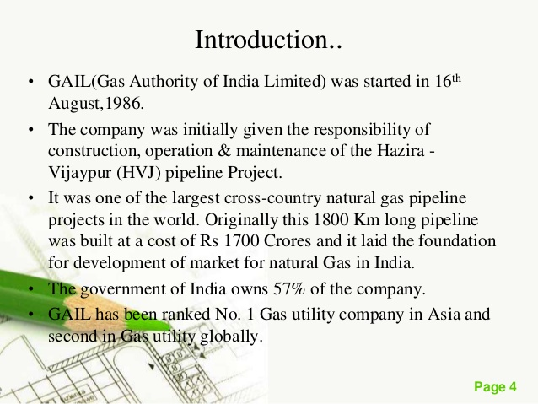

Slide 3
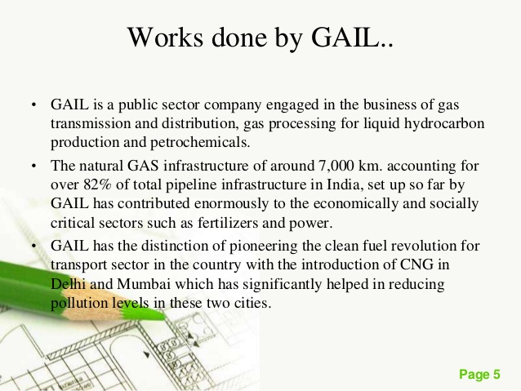

Slide 4


Slide 5
VISION
Be the Leading Company in Natural Gas and Beyond, with
Global Focus, Committed to Customer Care, Value Creation
for all Stakeholders and Environmental Responsibility.
MISSION
To accelerate and optimise the effective and
economic use of Natural Gas and its fractions to the
benefit of national economy.

Slide 6
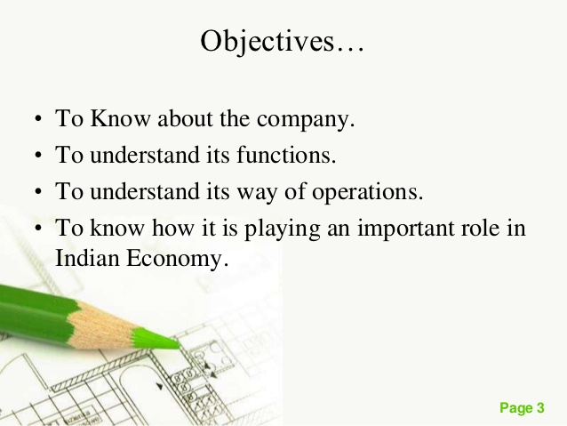

Slide 7
SWOT ANALYSIS

Slide 8
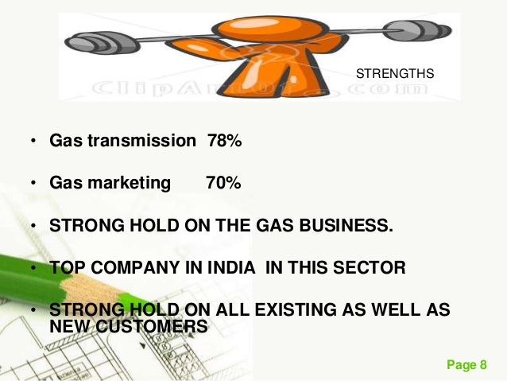

Slide 9
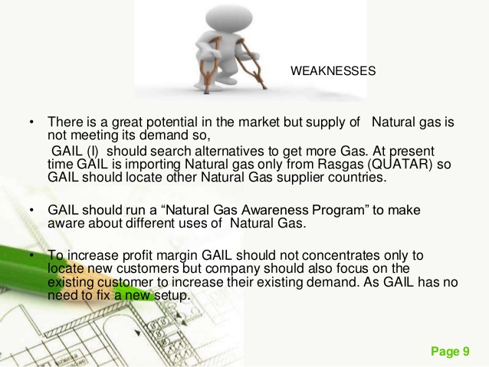

Slide 10


Slide 11
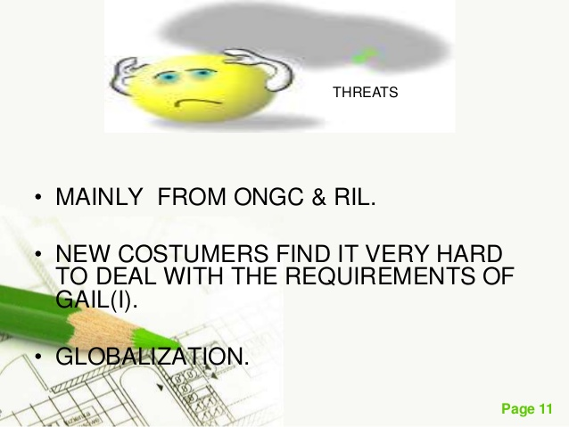

Slide 12
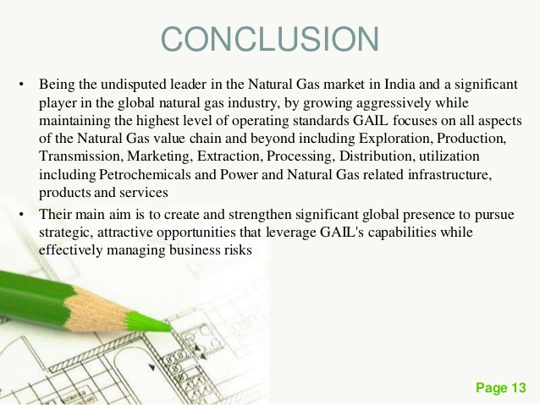

Slide 13


THANK YOU

